Slide 1
Industry Primer – Technology, Media, Telecommunications
Tuesday, October 4th, 2016
Presented by: Peter Fusca

Slide 2
Agenda
Technology Overview
Media Overview
Telecommunications Overview

Slide 3






I
Technology

Slide 4
Technology – Landscape
The Technology industry can be broken down into 6 different sectors
Communications Equipment
Computer Systems
Internet/Digital Media
Semiconductors / Hardware
IT Services and Payment Processing
Software

Slide 5
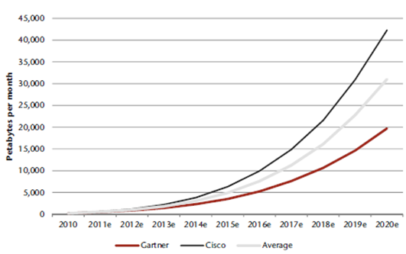
Technology – Trends
New things to do with the Internet are constantly emerging (e.g. social networking)
Broadband, processing power and near-free storage
The race for data supremacy, and data analytics
Strong Internet traffic growth drives data center demand
The need to manage fast-growing network traffic
Global Mobile Data Usage Forecast

Slide 6
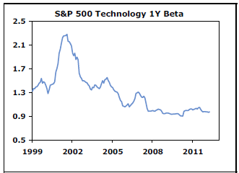
Technology – Trends
If taking a top-down investment approach, remember:
Technology is an early-cycle performer
Technology investment is sensitive to macroeconomic growth and business cycle
Technology is about market beta due to recent earnings stabilization and increase of cash reserves

Slide 7
Technology – Valuation
Valuation of a Technology company largely depends on the stage of the company itself
Early Stage
Mature Stage
EV / Unique Visitors
EV / Subscribers
EV / EBITDA
P / FCF
User Growth
Stickiness
P/E
DCF
EV / Sales
EPS Growth
NAV Analyses
Public Comparable

Slide 8
Technology – Investment Considerations
There are 3 things to keep in mind when investing in Technology companies
Geographic and Currency Exposure
Use of Cash
Business Models Against Growth Themes

Slide 9






II
Media

Slide 10
Media - Landscape
Media companies engage in the creation, aggregation, and distribution of content and then leverage this content to sell advertising based on audience metrics (e.g., readership, viewership) and generate subscription or advertising revenue
The traditional Media landscape looks something like this
Social Media
Consumer Products (Licensing)
Movies & TV Studios, Cable
Publishers
Newspapers
Magazines

Slide 11
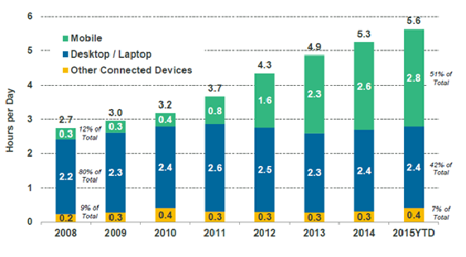
Media - Landscape
Transition to digital and mobile world
Increase of non-traditional distribution channels (YouTube, Twitch.tv)
Future of advertising - digital/online has overtaken broadcast television
Media access though mobile phones, fastest growing sector of media spending
Time spent per Adult User per day with Digital Media
Notes:
- nearly two-thirds of smartphone owners have watched video on their device.
-digital/online has overtaken broadcast television as the largest ad category in terms of spending size (largest growing segment is mobile internet advertising)

Slide 12
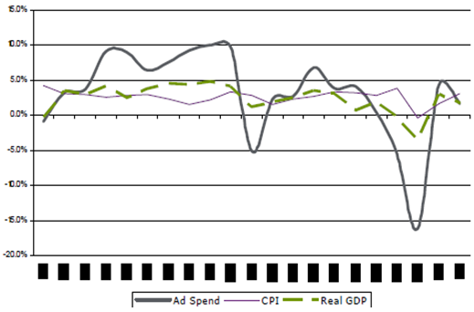
Media – Macroeconomic View
If taking a top-down investment approach:
Media is a high beta sector
The media industry, highly levered to both consumer services spending as well as business investment spending,
Trades best in the middle of the business cycle, when economic stability is fairly well established.
Ad spending vs. Real GDP and CPI Yr/Yr Growth
Notes:
– when stocks broadly rise, media stocks will likely benefit, but when stocks fall, media stocks will feel the brunt of declines.

Slide 13
Media - Valuation
Popular Valuation Metrics and Methods
P/FCF
DCF
EV/EBITDA
Sum of the Parts
Notes:
Price-to-Free Cash Flow (P/FCF) Multiple: Price to free cash flow has become the most popular determinant of relative value among media stocks.
Enterprise Value-to-EBITDA (EV/EBITDA) Multiple: Enterprise value to EBITDA is the metric used most by investors who cover a variety of sectors, as this metric tends to compare companies regardless of discretionary management decisions, such as capital structure. (Reflective of company operations)
DCF Analysis: The diversified group has a reasonably steady flow of cash generation, even in recessionary periods
Sum-of-the-Parts Analysis: Fair market value multiple is applied to forward looking cash flow for each sub segment within a diversified media company. They are then summed, and discounted at a rate usually between 10%-20%.

Slide 14
Media – Investment Considerations
Return of Capital. Appealing to the yield-starved investor, the large media players are in a mode of returning capital to shareholders in the form of large-scale share repurchase authorizations and dividends.
Top-Line Growth. Since media is heavily dependent upon advertising, and advertising is closely correlated to GDP growth, many investors monitor top-line growth of various media entities, especially in weak macroeconomic times, as a barometer of industry health.
Margin Expansion. Thanks to the explosion of media content across various screens (e.g. televisions, smartphones, tablets), most media companies are monetizing their content onto new channels, and this is driving margin expansion.

Slide 15






III
Telecommunications

Slide 16
Telecommunications - Landscape
Telecommunications in its simplest form may be defined as a service enabling communications for both consumers and businesses. Today, telecom companies offer a variety of services—voice, data, video and other strategic services.
The traditional Telecom landscape looks something like this:
Radio
Telephone & Mobile Phone Service Providers
Internet Service Providers (ISPs)

Slide 17
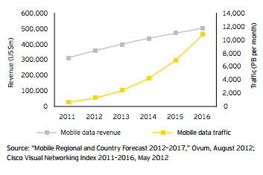
Telecommunications - Trends
Wireline Model is being redefined – transitioning from wireline/long-distance revenue to managed hosting, cloud storage, & IP
Spectrum – Wireless communication travels via Radio Frequency, defined as spectrum.
Regulatory environment - The Canadian Radio-television and Telecommunications Commission (CRTC) exists solely to regulate the telecommunications industry. Pricing and margin are critical issues for telecom.
Global Mobile Data Revenue and Traffic Growth
Notes:
Canadians spent more on mobile wireless services than any other communications service (36%) followed by home television service (28%), internet service (19%), and home telephone service (17%).
Spectrum is valuable because it is scarce and because there are limits on how much capacity can be delivered over the limited amount that is available.
Pricing and margin are critical issues for telecom.
Plot shows that data cost increases are linear while data traffic increases are exponential. Shows Cost per bit decreasing over time.

Slide 18
Telecommunications - Valuation
The Standard Valuation approaches apply Telecom companies: Public Comps, Precedent Transactions, & the DCF
Some important margins and key performance indicators are:
Popular Valuation Metrics
Popular Operating Metrics
Average Revenue per Account
Churn
EV/EBITDA
Div. Yield
EBITDA/
Subscribers
SAC/SRC
EV/
Subscribers
Net Debt/ EBITDA
Subscriber Penetration
Revenue Growth
Notes:
ARPA = Average Revenue per Account: Captures customer spend. Better than ARPU as more and more customers are owning more than one sim.
Churn = annual percentage rate at which customers stop subscribing.
SAC/SRC = Subscriber Acquisition Cost/Subscriber Retention Cost = gives the average cost of acquiring and retaining per customer.

Slide 19
Telecommunications – Investment Conisderations
Balance Sheet and Financing Needs. The wireless industry is especially capital intensive. High debt is the result of big capital expenditures.
Regulatory Environment and Competitive Landscape. Telecom is a highly regulated industry, which mandates investors keep an eye on pending regulatory changes. Meanwhile, telecom (especially wireless) is an extremely competitive industry.
Free-Cash-Flow Potential/Sustainability. With the highest dividend yield and highest dividend payout ratio among sectors in the index, dividends are a large part of the telecom story. Commitment to dividends has elevated telecom as a defensive sector.

Slide 20
Thanks!

